Slide 1


Ysgol Golwg Y Cwm
GWEITHIO I RAGORIAETH – PLANT SY’N DOD YN GYNTAF!
High Expectations
Aspirations to succeed
Feeling safe and valued in our diverse family
Active, enterprising citizens
Nurturing each other, Never giving up!
Gofalu
Ysgol
Cymuned
Hendreladus , Ystradgynlais, Swansea,SA9 1SE
Tel : (01639 846070) Email-office@golwygycwm.powys.sch.uk
Updated 01/09/20

Slide 2
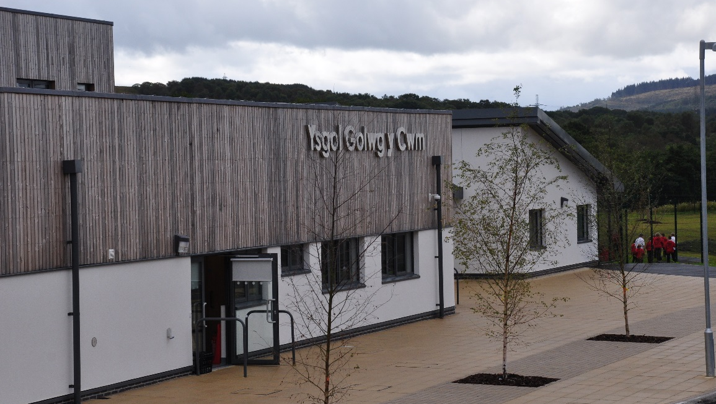
Our School
NOTE:
To change images on this slide, select a picture and delete it. Then click the Insert Picture icon
in the placeholder to insert your own image.
Ysgol Golwg Y Cwm is a modern, purpose built, Community Focused, English medium, Primary School in the Ystradgynlais area. The school was built in 2012, as part of a County modernisation programme, to accommodate up to 240 children. At present there are approximately 200 children at the school.
The school building is set well back from the road and is extremely pleasant and well resourced. The school is a
modern building with 6 mainstream classrooms and 2 Area Additional Educational Needs bases.
The school also houses a Flying Start setting for 2 year olds
and a 3/4 Year Old setting.
Our school has large sports fields which are shared with a community group, a Multi Use Games Area, a woodland area,
a quiet courtyard area and a playground, which runs around
the perimeter of the building.
HEADTEACHER: Mrs T Havard
CHAIRPERSON OF GOVERNORS: Cllr H Williams
Hendreladus, Ystradgynlais, Swansea, SA9 1SE Telephone 01639 846070

Slide 3
Aims and Objectives
Aim
At Ysgol Golwg Y Cwm, we aim to work together as teachers, parents and governors, to provide the best possible education that will equip our children for life and work.
Ethos
To create a climate within our school of understanding, care, worth and of mutual respect.
To achieve equality of opportunity by delivering a curriculum which gives all children the chance to realise their full potential, by fostering respect for religions and moral values, and tolerance of other people’s creeds and cultures.
To promote learners’ bilingual skills and reflect the language and culture of Wales.
Quality of Education
To promote the acquisition of relevant knowledge, skills and understanding, and enhance the quality and effectiveness of learning through activities that children find meaningful and stimulating.
To help children develop lively, enquiring minds and the ability to reason.
To help develop the skills of concentration, application, self-discipline and maximise their capacity to learn by encouraging self-confidence.
Curriculum
To provide a curriculum that is broad, balanced, relevant and appropriate to the children’s needs in order to promote the all-round development of every child.
To ensure that all children acquire the essential skills of literacy, numeracy and communication, and develop the ability to use these effectively.
Leadership & Management
To create a working environment which all staff find stimulating and supportive, where their contributions and skills are recognised and valued.
To maintain and develop a sound working relationship between governors, Head teacher, staff and parents for the benefit of the whole school community.
Equal Opportunities
We promote positive attitudes in children, staff, governors and parents so that the children can fulfil their potential and make choices, unhampered by expectations based on gender or role stereotyping. We seek to fulfil the aims of the school regardless of age, gender, ability (both academic and physical) ethnic origin or background of the child.
Resources
To provide staff with opportunities for professional development.
To provide value for money within a balanced budget.

Slide 4
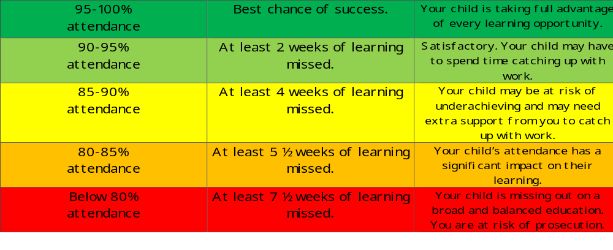
Attendance
Target 2026 – 2027: 92.5%
Target 2025 - 2026: 92%
Autumn – 92% Spring 92% Summer 92%
Good attendance is really important for your child’s learning and wellbeing. At our school, we aim for every child to attend every day possible, and we support families through clear monitoring and helpful communication.
Attendance is monitored in several ways to ensure that we can identify any concerns early and celebrate great effort.
If your child is absent, please inform the school on the first day of absence. Even when a child’s absence is authorised (for example, due to illness, medical appointments, or other authorised circumstances), these days are still classed as absent in attendance figures.

Slide 5

https://drive.google.com/file/d/1iAevR7eph5fHLbbHqm-AyMabioLaivH2/view

Slide 6
Cymraeg @ Ysgol Golwg y Cwm
At our school, Welsh is an important and valued part of everyday life. Although Welsh is our second language, we are incredibly proud of the confidence and enthusiasm our children demonstrate in understanding, speaking and reading Welsh. We are committed to creating a positive and supportive environment where Welsh is heard, seen and celebrated throughout the school.
Welsh lessons take place every week, while Helpwr Heddiw activities provide children with daily opportunities to practise and use their Welsh in a fun and meaningful way. Welsh signage features prominently throughout our classrooms and displays, helping to make the language a natural part of the children’s learning environment. Our staff use as much Welsh as possible throughout the school day and incorporate Welsh across the curriculum, giving pupils regular opportunities to hear and use the language in a range of contexts.
Our Criw Cymraeg meet regularly and play an important role in promoting and celebrating Welsh throughout the school. Children also enjoy reading Welsh books to younger pupils, encouraging a love of reading and helping to build confidence in using Welsh with others. Our Welsh Club, open to all pupils from Year 1 to Year 6, provides an additional opportunity to develop language skills through engaging and enjoyable activities.
We also use Brawddeg yr Wythnos to introduce and reinforce useful Welsh phrases, helping children to build their vocabulary and use Welsh naturally in everyday situations. Our Welsh mascot visits a different family each week, encouraging children to share their Welsh learning and experiences at home.
We are currently working towards achieving the Gwobr Arian Welsh Language Award, reflecting our ongoing commitment to developing and strengthening the use of Welsh across our school community.
Above all, we want our children to see Welsh as a living, enjoyable and valuable language.
We celebrate every child's progress and take great pride in seeing our pupils develop the
confidence to understand, speak and read Welsh with increasing independence and
enthusiasm.

Slide 7
School Uniform
Our Governing Body considers school uniform, to contribute significantly to our school ethos.
Uniform helps to foster, in our children, an identity and pride in being part of our school.
Children should wear comfortable, appropriate clothing and footwear in school.
Stud earrings and watches are the only items of jewellery that may be worn.
School uniform can be purchased from ‘Pethau Plant’ in Ystradgynlais, 16 Station Road, Ystradgynlais, Swansea SA9 1NT.
01639 844747
In the interest of safety, the children should not wear loose or baggy T-shirts and shorts.
Long hair must be tied up and no jewellery or watches are to be worn during the P.E. and games lessons.
Indoor P.E. - Shorts and T-shirt
Outdoor P.E. – As above, plus trainers. Tracksuits can be worn throughout the winter
Swimming – Swimming costume (not a bikini or long shorts) and towel.
Red Sweatshirt/Hoodie/
Cardigan
(with or without the school logo)
Red and white gingham summer dress
White/Red Polo Shirt
Black Trousers/Skirt/ Shorts/Pinafore

Slide 8
School Admissions
Administration for admission
All admissions to Golwg y Cwm are through application to Powys LA. The parent should apply to the authority through the admissions department in order to secure a place at the school Admissions officers can be contacted on 01597 826477.
Appeals against any decisions made should follow the County appeals procedure.
Upon entry to Golwg y Cwm, parents are required to complete registration and medical forms in full for each child.
This is very important since it provides us with essential information about contact telephone numbers in case of an emergency.
It is also important at this stage to note any particular conditions or needs a child may have e.g. allergies, dietary. Golwg Y Cwm utilise “Seesaw” and we would encourage parents to sign up for the free service with the class teachers to ensure you receive regular information electronically from the school including details of events and school trips.
Into Ysgol Golwg Y Cwm…
The Ser Bach Y Cwm Playgroup is the main setting from which rising 5 year olds come into our Reception class. The playgroup can accommodate up to 67 children on a part-time basis. Children can start at Ser Bach y Cwm the term after they are 2. If the children live within the Flying Start area they are eligible for 10 hours free funding. All children are eligible for government funding the term after they 3rd birthday. Children aged 3/4 and above are entitled to 10hours free childcare.
Ser Bach y Cwm is part of the school, which means there is a smooth transition to the Reception Class. This is further facilitated by the children and parents being invited to spend a number of sessions in the Reception class the term before they are due to start. This enables them to get to know their new teacher, surroundings and classmates and prepares them for life in the Nursery Class.
And out again...
When children in Year 6 transfer to the secondary school of their choice, every effort is made to prepare them for this exciting move. Staff from Maesydderwen visit the school and the children and in turn, spend a number days at the secondary school throughout their year in Year 6. Information records are transferred to the respective schools, and pupils complete transition booklets, which accompany them to their new destinations.
Our aim at Golwg Y Cwm is to have equipped our pupils with the life skills necessary to cope with the transfer
and enable them to fulfil their potential in whatever they choose to do.

Slide 9
Daily Routines
The Head teacher and Deputy Head teacher are usually available to meet and greet parents in the morning. However, there are times when the Head teacher is attending meetings. Please contact the school to make an appointment whenever possible.
Visitors and Parents are welcome to visit us at any time. When visits are made during the day they are requested to sign in at reception so that, in case of emergencies, staff know who is on the premises.
Main School Hours.
Morning session: 8.50a.m. – 12.15p.m.
Break: 10.40a.m. – 11a.m.
Lunch: 12.15p.m. – 1.15p.m.
Afternoon session: Infants – 1.15p.m.3.15p.m.
Juniors – 1.15p.m. – 3.15p.m.
Break: Infants – 2.15p.m. – 2.30p.m.
Ser Bach Y Cwm
Ser Bach y Cwm offers wrap around day care. Session times for the 2 year old setting, the 3 year old setting and the wrap around child care can be obtained from the school office.
Children should be collected promptly. Please complete a “collection at the end of the day“ form. If you are unable to collect your child because of an emergency, please let the Head teacher know. Late collections cause unnecessary distress to the children involved.
We expect all children to arrive at school punctually. However, for reasons of personal safety, no child should be sent to school unduly early, unless they are attending Breakfast club which runs from 8.00 am until 8.30am.
Teachers assume responsibility for the children at 8.40a.m. and at the end of the school day until 3.25p.m.

Slide 10
Daily Routines
Lunchtime Arrangements.
Children may have a hot school dinner or bring a packed lunch if preferred.
Dinner money is now collected online via parent pay. For further details please contact Mrs Ace - School Secretary
A supply of water is always available in the cloakrooms and in the classroom. Children may bring their own water if they wish, but on no account should glass containers be sent to school.
Some families are entitled to free school meals. Information can be obtained from the School secretary .
Mid-day supervisory assistants are employed to look after the children whilst they are eating and playing.
Children are not allowed to leave the premises at lunchtime. They must respect the supervisory assistants at all times and where children cannot meet our expected code of behaviour during this period, parents will be asked to make alternative arrangements for them.
Break time Snacks.
Children are requested to bring a healthy snack. E.g. fruit, yogurt or cheese.

Slide 11
Additional Learning Needs
The school actively encourages the involvement of all staff, pupils and parents in the education of pupils with ALN.
All class teachers, together with the ALNCO are responsible for the initial identification and assessment of ALN. They also have responsibility within the classroom. Parents will be consulted as soon as identification is made so that an appropriate curriculum and support is provided for the child. The school will make every opportunity to meet the needs of all pupils.
From September 2021 the new Additional Learning Needs Code will begin to come into effect. All learners newly identified as having ALN will be supported through the new system of Individual Development Plans. In Powys this is managed through the TYFU system.
Pupils already in the SEN system are being transitioned over to the new ALN system, starting with those who have low to moderate needs. Those with more severe or complex needs (who currently have “statements” of SEN) will move to the new system later in the three-year period. And the timing will also depend on which year group a pupil is in. This year pupils in years 1,3,5, will transfer to the new system.
A range of support services are involved with pupils at our school. We believe that partnerships with external agencies are essential in order to meet the needs of our pupils.
The school also has 2 Area Learning Support Classes to meet the needs of learners with moderate learning difficulties. Admissions to these classes are via application to a local admissions panel.
PROVISION FOR DISABLED PUPILS
The school is fully adapted to cater for the needs of disabled pupils. All areas of the school are fully accessible.
LAC / CHILD PROTECTION
Mrs Tracey Havard is responsible for promoting the educational achievement of looked
after children. Their progress is monitored closely and needs addressed accordingly.
Mrs Havard attends LAC reviews with the Local Authority.

Slide 12

Parental Involvement
A successful school relies upon the good will and active involvement of the parents and in respect Ysgol Golwg y Cwm is no exception. Besides membership of the PTA, we value the skills and time you may have to offer. There are a number of ways you can help your
child (ren) and enhance the life of the school.
Firstly you can help your child with basic literacy and numeracy skills by:
* Reading with your child.
* Listening to them reading to you.
* Encouraging the use of numbers at home.
* Supporting them with any homework.
* Participate in family learning activities at Golwg Y Cwm
Parents are invited each term to visit the school to examine pupils work and their progress alongside their child and the class teacher.
Parents are also welcome to attend our coffee morning/ drop in, on a Thursday morning which is organized by Amber our family liaison officer.
A range of parental engagement workshops are available to parents.
Many of our extra curricular activities rely on supportive staff and parents for success. If you can help,
We greatly appreciate your support!

Slide 13
Parental Involvement
The Family and Community Together (FACT) project is a family learning programme based at Golwg Y Cwm that aims to:-
Support parents to feel more confident in supporting their children
Support parents who feel their child is coping better at school
Support parents to become more actively engaged with the school collectively
Friends of the School
All parents are automatically members of the Friends of the School committee. We hope you will be able to support activities and events and actively contribute to the invaluable work done by parents to support children’s education at Ysgol Golwg y Cwm. The friends of Golwg Y Cwm meet regularly. Dates and times of meetings are displayed on the Parent and Community Boards within the school and advertised on the Friends of Golwg y Cwm face book page.
The Friends of the School committee exists to help parents become involved in the life of the school. It is important that as many parents as possible attend the Annual General Meeting in the early part of the autumn term so that new parents can be introduced to the school and become actively involved from the outset.
Community School
Golwg Y Cwm has 2 community spaces and a community office. The following organisations are based in our Community Office:
Flying Start Health Visitors
Calan - Domestic abuse service
Family Liaison Officer

Slide 14
Other School and Home Links
Homework
Appropriate homework is given regularly to children in Year 1 to Year 6 classes. Home-School tasks are given to children in the Reception class. Your help and support with homework, when needed, will further your child’s achievements at school. Regular reading practice, learning spelling patterns and mental maths games are always necessary. Where possible homework is provided via HWB.
Home-School Links
As parents, you are your child’s first and most important educator. At Golwg y Cwm, we value and appreciate the important role you have to play in supporting your child in developing a positive attitude to school and learning. Studies have proven that children learn best when home and school work in partnership. Every term Ysgol Golwg Y Cwm holds a Parents and Child work discussion. Parents can ask any questions and the teachers can explain to parents about expectations for their progress for that year. An information booklet is available for all parents.
Informing Parents
The school strives to keep parents informed at all times, of activities, events, etc by, the school notice board and See-Saw . All parents are encouraged to sign up to See-saw so that parents can receive up to date information regarding events at the school.
Emergency Closure
From time to time, especially in the winter, situations may arise where it is necessary to close the school. Where possible parents will be informed the day before the school is to close. However, if the school has to close at very short notice, a notice will be placed on the school gate and whenever possible staff will be available to answer the telephone if you call the school. Parents can also get information from the Powys website and from See Saw message from the class teacher.

Slide 15
School Council
NOTE:
To change images on this slide, select a picture and delete it. Then click the Insert Picture icon
in the placeholder to insert your own image.
Pupils at the school are represented by a School’s Council:
A new council is elected annually in September.
There are class councillors from Year 3 to Year 6.
Classes propose their nominees and a secret ballot is then held to vote for the class representatives.
The elected councillors then choose their chairperson a secretary .
Meetings are held throughout the year in class which are minuted where various issues are discussed and resolutions are made. These are taken to official council meetings with SMT Staff. A suggestion box is available for all ideas from any members of the school community
The School’s Council has a very important role to play in the general well being of the school and its pupils.
Playtime activities
Friendships
CYNGOR YSGOL GOLWG Y CWM
Fruit Stall
Learning Walks
Bullying
The School’s Council officials have regular meetings with the SMT to discuss matters that have arisen in meetings and to put forward requests, ideas and solutions to problems that arise in their everyday school life.

Slide 16
Instrumental Tuition
Key Stage 2 pupils at Ysgol Golwg Y Cwm have the opportunity to receive percussion lessons. These are delivered by a visiting music teacher, employed by outside agencies.
We are also fortunate to receive some music tuition from the Music specialist at Ysgol Maesydderwen.
To ensure continuity and progression, Ysgol Golwg Y Cwm has endeavoured to use the same music tutors as the local comprehensive schools. This enables pupils to carry on with their sessions smoothly on transition from Year 6 to Year 7.
Instrumental tuition lessons are provided on a weekly basis at a reasonable cost, which is fixed at the discretion of the school, according to overall costs and demand.
Tutors
Drums Music Mr Ray Dizon Mrs Deborah Clear

Slide 17
Inspiring a Love of Sport and Physical Activity
At our school, we are committed to providing every child with a wide range of opportunities to be active, develop their physical skills and discover a love of sport. We believe that sport and physical activity play an important role in developing healthy, confident and resilient children, while also teaching valuable skills such as teamwork, determination, communication and perseverance.
Our children are fortunate to benefit from expert coaching and specialist support during school lessons, giving them the opportunity to develop their skills in sports including football, rugby and cricket. We aim to ensure that children of all abilities are encouraged to participate, develop their confidence and experience the enjoyment that comes from being active.
Our annual Fit Fortnight provides an exciting opportunity for children to experience an even wider range of physical activities. Throughout the fortnight, pupils take part in activities such as gym visits, football, rugby, boxing, running, gymnastics, yoga, walking and cycling or scooting, allowing them to discover new interests and understand the importance of keeping active in a variety of ways.
We offer a varied programme of extra-curricular sporting activities, with weekly opportunities including netball, rugby, football and hockey. Our children are also proud to represent the school at cross-country events, tournaments and festivals, regularly participating in netball, rugby and football competitions. These experiences help our pupils develop their competitive spirit while, most importantly, promoting teamwork, sportsmanship and respect for others.
We recognise that physical activity extends beyond traditional sports. Through our Outdoor Forest School sessions, children take their learning outside, making use of our dedicated Forest School area and the local environment. These experiences encourage children to be active, adventurous and curious, while developing their understanding of the natural world.
Our aim is for every child to leave our school with positive attitudes towards physical activity,
an appreciation of the benefits of an active lifestyle and the confidence to participate in sport
both within school and beyond. We strive to provide opportunities for every child to be active,
have fun, challenge themselves and discover what they enjoy.

Slide 18
Extra Curricular Activities
GARDENING CLUB
Pupils in Years 1&2 are invited to join this club.
READING CLUB
Children in Years 3-6 are invited to attend Reading Club.
INFORMATION TECHNOLOGY (I.T.)
The I.T. club meets on a timetabled basis. It is open to all children in Year 6. The children are given the opportunity to learn new I.T. skills and to develop existing skills. The children produce many useful documents for the school, which include newsletters and programmes for concerts.
CHOIR
Children in Years 3-6 are invited to attend Choir.
CLWB CYMRAEG
Children in Years 1 - 6 are invited to Clwb Cymraeg in order to develop their Welsh language skills.
PIGGY BANK SAVINGS CLUB
In partnership with Brecon and district credit union we have a schools savings scheme for pupils based in Golwg Y Cwm on a Wednesday.
NETBALL/HOCKEY/
FOOTBALL/RUGBY
Sports clubs are run on a rota basis throughout the year for children in Years 3-6.
BIG BOOK LIBRARY
The library is open for families to attend on a Wednesday afternoon 3:15 – 4pm.
VISITS AND EXCURSIONS
Throughout the year, children have opportunities to visit the theatre and places of interest to support the work done in the Curriculum. Pupils in Year 4/5 have the opportunity to develop their Outdoor Education skills inThe Summit Centre, and pupils in Year 6 visit Llangrannog.

Slide 19
Collective Worship
Collective worship takes place on a daily basis.
Whole school assemblies take place on a Monday, Tuesday and Friday. Wednesday and Thursday assemblies are class based assemblies.
Parents may exercise their rights, under the 1998 Education act, to withdraw their child from assemblies
If you wish to do this, please contact the Head teacher.
Christmas at Ysgol Golwg Y Cwm.
At Christmas time, the school celebrates in a variety of ways:
* Pantomimes/ Musicals
* Nativity or Christian based plays
* Carol services
* Town/ Community singing
* Parties
Parents are informed of the forthcoming events for the festive season and if they wish to withdraw their children from any of the activities they are requested to inform the class teacher or the Head teacher in writing prior to rehearsal times.

Slide 20
Assessment and Reporting
Promoting children’s learning is one of the main aims of the school. To ensure this process is efficient and effective, assessment plays a large part. It provides a framework in which educational objectives may be set & pupils’ progress charted and expressed. This can then offer a basis for planning the next steps in response to children’s needs.
Parent and child work progress trawls are held each term, where parents and teachers are able to discuss the teaching and learning and progress of pupils and the pupils are able to explain themselves their progress. An Annual report about your child’s progress, in all areas of the curriculum, is also prepared at the end of each Summer term and parents are given the opportunity to respond. Duplicate reports can be obtained for both parents upon official request to the Head teacher.
Teachers make day-to-day judgments about children’s progress in order to plan for their progression. Assessment for Learning is an important part of our assessment process. We also use published assessment materials to help monitor children’s progress & development. We undertake a baseline assessment of each child in reception. Children also undertake CATS testing at Year 4; and National Literacy and Numeracy tests are delivered to children in Years 2,3,4,5 and 6 and provide useful information.
The progression of pupils with Additional Learning Needs is also planned for, through Individual Development Plans. (IDP’s) and Provision Maps. All schools within Powys use the TYFU platform to record and store all information related to ALN . Parents and children are encouraged to be involved in this target-setting process.
Parents are always welcome to visit the school to discuss pupils’ education and welfare. It is advised, however, that enquiries are made to check whether the teacher is available at a time convenient for both parties. You can of course contact the Headteacher if you need to discuss any matters urgently.

Slide 21
Health, Care and Discipline
Health.
It is vitally important that we know if your child has any health problems e.g. asthma, allergies.
The school nurse visits regularly and carries out screening tests for hearing and vision; dental inspections are also carried out. Parents are notified when these visits are arranged and are welcome to attend if they wish.
The school nurse must be informed if parents wish to be present.
A note should be sent if your child has to be excused from any part of the P.E. programme.
Children cannot enjoy school or do their best if they are unwell; please nurse them at home until they recover.
If your child has to have any medication during the school day you must consult the Head teacher to discuss the matter and complete a medication form
Head lice are often uninvited guests at school; please check your child’s hair routinely.
Illness or accident whilst in school.
If your child is ill or has an accident, we let you know and usually ask you to collect him/ her. We keep all contact telephone numbers on file and expect parents to inform us immediately if numbers or addresses change. In the case of a serious injury, we try to contact the parent as soon as possible and ensure that the child is taken to Ystradgynlais hospital, which is nearby. All head injuries will result in immediate contact by telephone. Parents are asked to visit the school to observe the child and to decide whether they should stay in school. Any major accident an accident forms will be filled out and sent to the LEA.
Behaviour
We expect consistently high standards of behaviour so that all who work in the school can do so safely. We promote positive praise and reward, however sometimes children exhibit unacceptable behaviour which is dealt with promptly and through a restorative approach whenever possible. Serious breaches of our Code of Conduct will result in the pupil being disciplined by our Senior Management Team.

Slide 22
School Security
The security of the pupils, staff and all visitors is of utmost importance to the school and every effort is made to ensure that everyone involved should maintain a high level of awareness of security issues at all times.
We also aim to maintain maximum security of the site, buildings and contents of the school constantly.
School security is to be managed as a part of a continuing process, rather than in response to a particular incident.
In order to ensure a safe environment for the children, all visitors must sign in and out at the main reception so that adults present on site are accounted for and are known to the staff.
All children are left in the care of their teachers no earlier than 8.40a.m. and collected no later than 3.25p.m. During this period of time the staff have the safety and well being of the children as their ultimate concern throughout. No child may leave the school without prior consent from the parent/ guardian, i.e. trips. Pupils will not be able to participate without prior consent. The admissions form contains one consent form, which covers us to take your child on a local visit i.e. local walk.
Parents also need to be responsible for informing the school if another adult will be collecting the child at the end of the school day. No child will be handed over to an unauthorised person.
The school also has a separate bomb threat policy, which follows the LEA guidelines on Bomb Threat Procedures.

Slide 23
School Security
Fire drills are held each half term. All pupils are aware of the procedures upon entry into each new classroom at the beginning of the new school year and guidelines are displayed in each classroom.
The Governing Body is informed of any issues arising from the drills and measures are taken to rectify any problems as soon as possible. Regular inspections are made on the fire-safety equipment and logs are kept.
The local fire brigade occasionally visits the school to talk to the children about fire hazards and demonstrate the use of the fire engine and safety equipment.
The main entrance exterior doors are locked during the school day, as are the side gates and the only means of entering the building is through the main entrance, to the reception area for signing in. Internally there is also a secure system for entering the school part of the building. You cannot leave the school building without being fobbed out.
Parking
Parents delivering or collecting children by car are asked to park in the car park. Please do not park in the drop off/ pick up bay outside the main entrance as this is reserved for school buses or in the designated parking area unless you are a blue badge holder.

Slide 24
Complaints Procedures
We strive to deliver the best possible education to our pupils and to care for their health, safety and welfare at all times.
All the staff of this school; teaching and non-teaching are dedicated to this aim.
From time to time, however, it is possible that you feel we have not lived up to your expectations. If this is the case please tell us at once. First, talk to the teacher concerned and/or the Head teacher. We will do whatever we can to resolve any reasonable problem that is brought to our attention.
Should you have any concerns regarding the curriculum, participation in acts of collective worship then once again please speak to the Head teacher who will deal with your concerns. If you feel that things are not resolved, then you should raise the matter formally with the governors. The procedure for doing this is available from the school, or from the Local Education Office.
School and LEA Policies.
Most of the information in this brochure are based on these policies.
Parents can request to see copies of all policies at the school.
Policies are also available on the school website.

Slide 25
Charging and Remissions
At Ysgol Golwg Y Cwm, education provided during school hours is free of charge, including all National Curriculum activities.
School Trips and Activities
We may invite parents and carers to make voluntary contributions towards educational visits and activities that enhance pupils’ learning experiences. Contributions are not compulsory, and no child will be treated differently if a contribution is not made. Visits may include museums, theatres, sporting and outdoor activities, musical events and school trips.
Residential Visits
Charges are made for residential visits to cover accommodation, meals and travel costs. Families experiencing financial difficulty are encouraged to contact the Headteacher confidentially to discuss possible payment arrangements.
Music Tuition
Curriculum music lessons are free. Additional individual or small-group music tuition provided outside the National Curriculum is chargeable.
Swimming
Swimming lessons are provided free of charge as part of the National Curriculum.
A voluntary contribution towards transport costs may be requested.
Families experiencing financial difficulty are encouraged to contact the Headteacher.

Slide 26
School Governors
Tracey Havard (Headteacher)
Cllr Huw Williams (Chairperson)
Kim Gaffney (Vice Chair)
Allison Griffiths (Deputy Headteacher)
Sharon James
Cllr Sarah Williams
Matthew Ace
Cllr Adrian Williams
Alex De Melverda
Helen Thomas
Nia Busby
Sian Jones

Slide 27
Golwg Y Cwm Staff
Ser Bach Y Cwm Playgroup.
Flying Start
Playgroup leader:
Miss Jess /Miss Naomi
Playgroup Assistants:
Miss Nicola Lewis
Mrs Charlene Flippin
Miss Chantelle Morgan
Teaching Staff.
Head Teacher: . Mrs Tracey Havard
Deputy Head teacher: Mrs Allison Griffiths
Derbyn / Blwyddyn 1: Mrs Sarah Gerard.
Blwyddyn 1 / 2: Mrs Caroline Williams
Blwyddyn 2/ 3: Mrs Natalie Edwards
Blwyddyn 3/4 : Miss Dionne Rowe
Blwyddyn 4/5 : Miss Shauna Davies
Blwyddyn 6: Miss Bethan Seabourne
Learning Support Class KS2: Mrs Hayley Bennett
Learning Support Class FP: Mrs Elizabeth Miller
ALNCO: Mrs Tracey Havard
PPA Teacher: Miss Sophie Jones
3/4 Year Old Setting
Playgroup Leader:
Mrs Adele Elton
Playgroup Assistants:
Miss Tina Watts
Miss Shelby Bateman
Mr Rhys Davies

Slide 28
Golwg Y Cwm Staff
Non-Teaching Staff.
School Administrator: Mrs Dawn Ace, Mrs Natalie Ace
Caretaker: Mr Rhys Colamazza
Cleaners : Mrs Lisa Holland
Mrs Gillian Davies
Cook in Charge: Mrs Mandy Owen.
Assistant Cook: Mrs Dawn Davies
Mid-day Supervisors:
Mrs Sarah Carter Miss Nicola Lewis Mr Cian Gwilym
Mrs Jayne Lewis Mrs Dathyl Hopkins Miss Emma Phillips
Miss Sam Leahy Miss Vicky Leahy
Miss Sharon Whitney
Breakfast Club supervisors
Mrs Sharon James
Mrs Jayne Lewis
Mrs Mandy Owen
Support staff
Foundation Phase
Mrs Hayley Bateman
Mrs Lucy Phillips
Miss Vicky Leahy
Miss Sharon Whitney
ALN
Mrs Sarah Carter
Mrs Sharon James
Miss Sam Leahy
Mrs Jayne Lewis
Mr Cian Gwillim
Mrs Dathyl Hopkins
Mrs Sharon Bufton
Mrs Amy Rees Davies
Mrs Andrea James
Miss Kayleigh Evans
Peripatetic Teachers
Percussion: Mr. Ray Dizon
Community/
Family liaison Officer
Miss Amber Charalambou
SEN CENTRES SUPPORT STAFF
Miss Emma Phillips Miss Rebecca Lewis

Slide 29
School Term Dates
2026 -2027
Autumn Term: Tuesday 1st September – Tuesday 22nd December 2026
Half Term: Monday 26th October – Friday 30th October 2026
Non-pupil days: Tuesday 1st September, Friday 23rd October, Tuesday 22nd December
Spring Term: Monday 4th January – Friday 19th March 2027
Half Term: Monday 8th February – Friday 12th February
Non-pupil days: Monday 4th January, Friday 30th April
Summer Term: Monday 5th April – Friday 16th July 2027
Half Term: Monday 31st May – Friday 4th June 2027

Slide 30
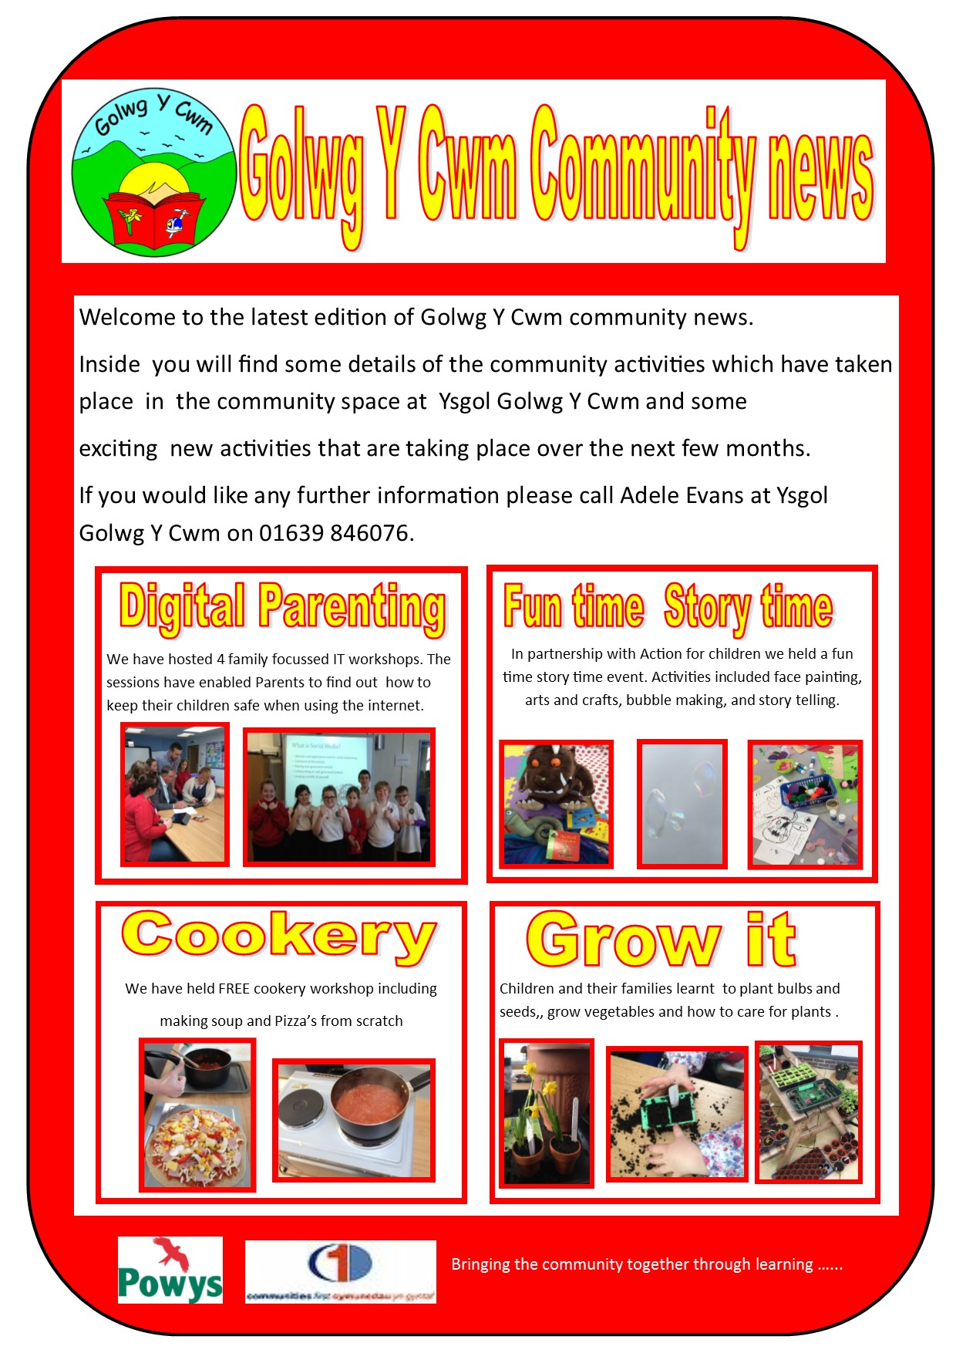
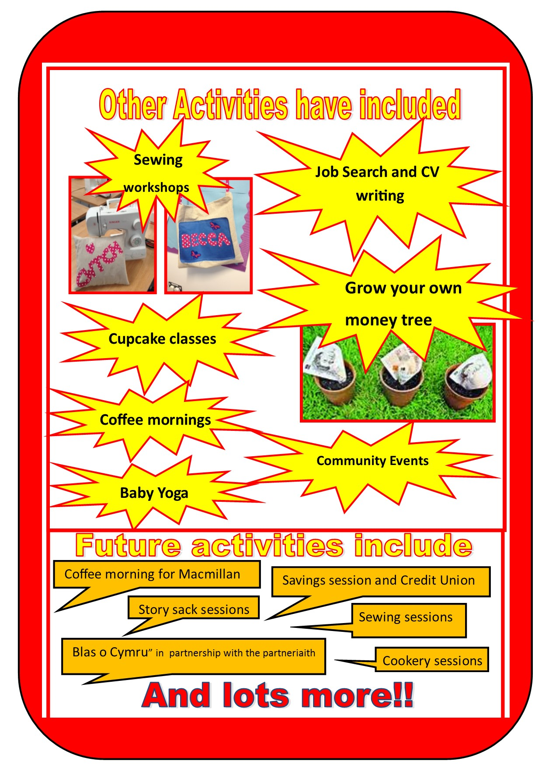
Family and Community Together

